Slide 1
Python Libraries for Image Recognition
Sklearn & TensorFlow are used for image recognition of different complexity
By: Horace, Kimi, Peiwen, Qinnan, Wenhui, Xiang
Notes:
As future data analysts, we feel it necessary to learn python libraries such as scikit-learn and tensorflow for machine learning tasks. Our project is specifically focused on image recognition task.
Today, our presentation and handout will showcase that Sklearn is easy to begin with for low-complexity image recognition, while TensorFlow is designed to deal with more-complexity image recognition.

Slide 2
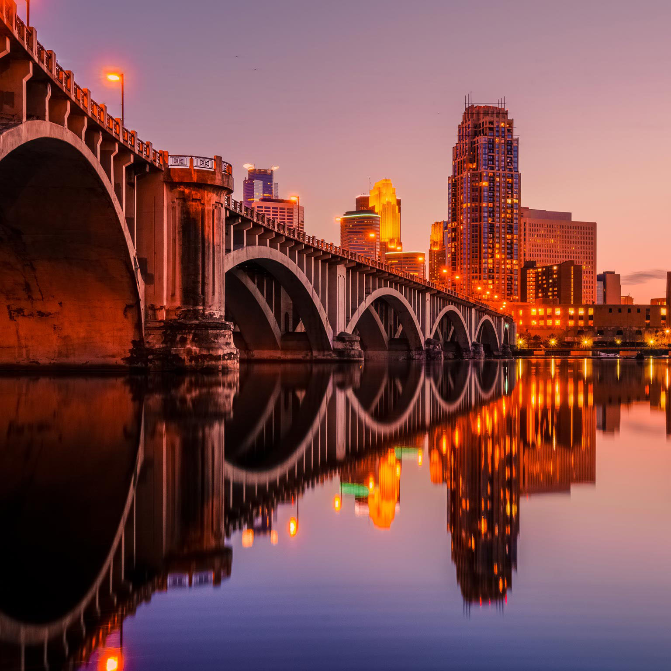
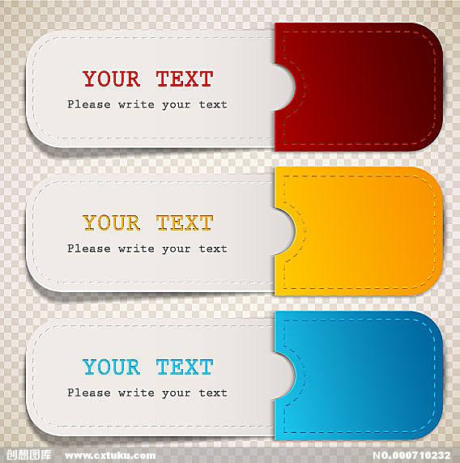

Image Recognition
Tag
Probability
steel arch bridge
0.44056
pier
0.26759
viaduct
0.09885
suspension bridge
0.03803
boathouse
0.01539

Slide 3
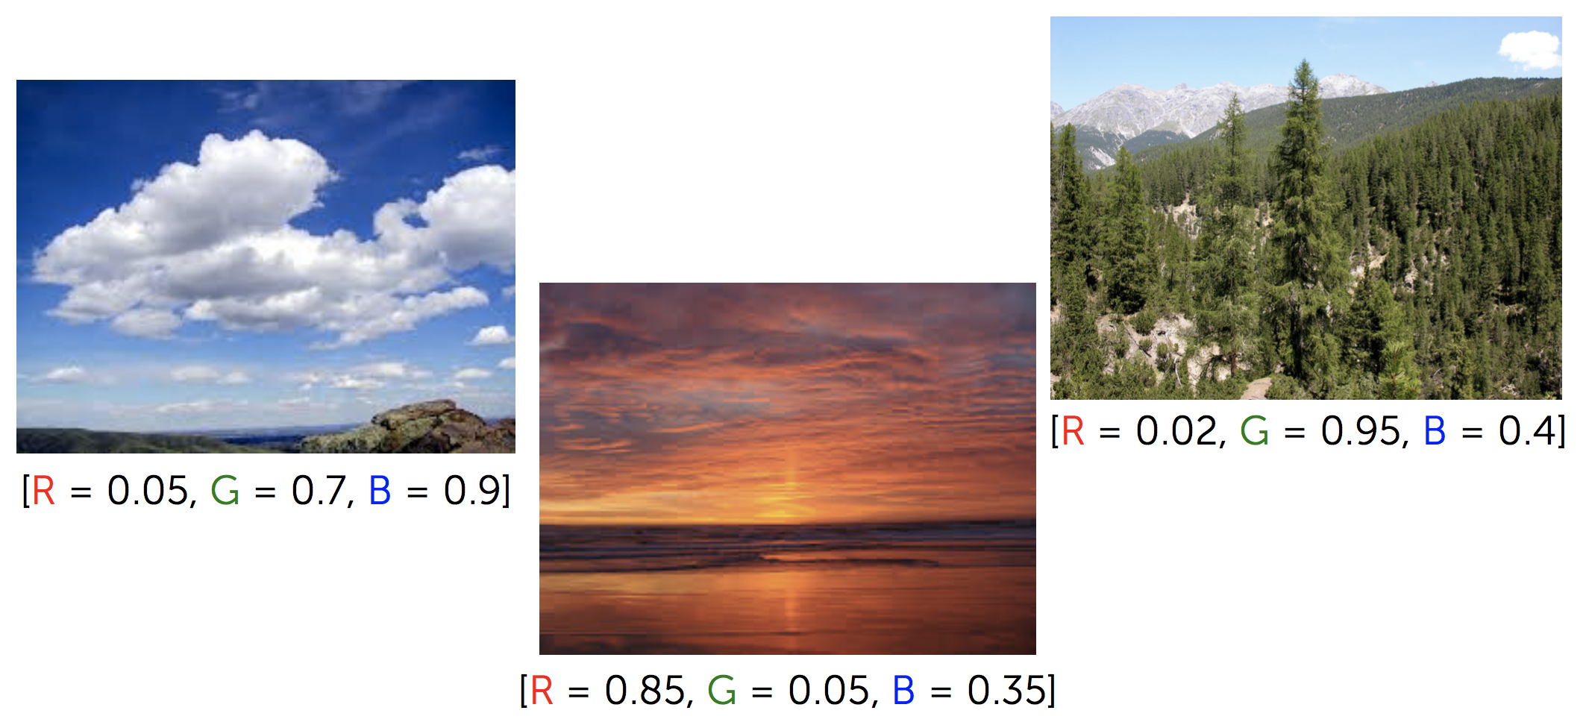
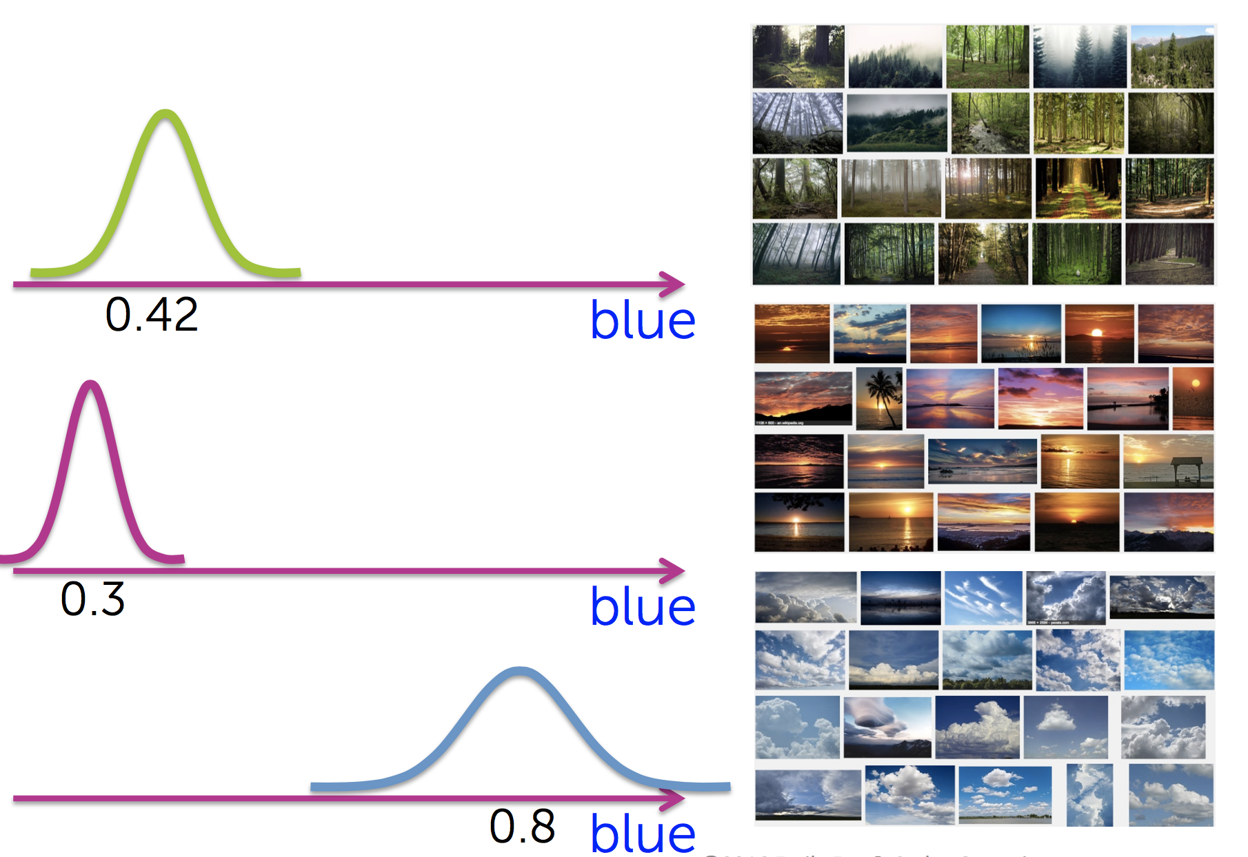
Preparing Image Data
2481 pictures of
‘Minnesota natural scenery’ parsed from Google
“Topic of the picture”
Assume each of RGB features for all pictures has a
Gaussian distribution.
from PIL import Image
Notes:
We parse more than 2000 pictures of Minnesota natural scenery which, as you can see, mostly contain simple elements and simple colors.
To start a basic image recognition task, we can derive a vector of RGB features from each picture.
If we take a look at blue color in different pictures, we will find out that for certain set of pictures, blue value is high while for other set of pictures, blue value is low. If we evaluate red or green color across all pictures, we will discover similar patterns.

Slide 4
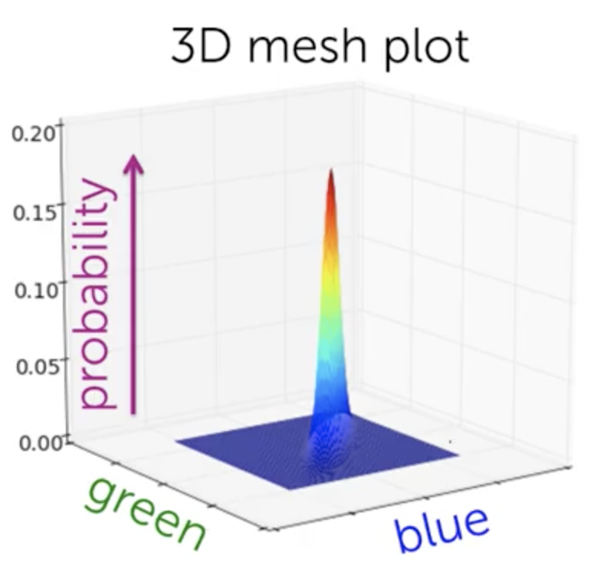
Fitting Gaussian Mixture Model
“Put hats on clusters”
Our task is to capture each of the cluster using different hats.
Like K-Means, but instead of centroids, we initialize a number of multivariate Gaussian distributions in hyperplane.
from scipy.stats import multivariate_normal
np.random.multivariate_normal(μ, ∑)
Notes:
Now let’s use only green and blue features and probability to form a 3D space.
This bivariate Gaussian distribution may stands for a set of pictures which are mainly about sky and a little of green trees. You can imagine there are other distributions that stand for other sets of pictures. So now, our task is establish some multivariate Gaussian distributions that look like a hat to cover these clusters. This is how the model name comes from.

Slide 5
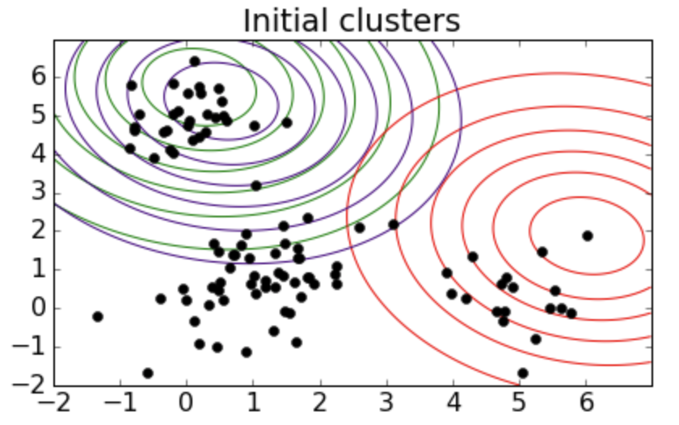
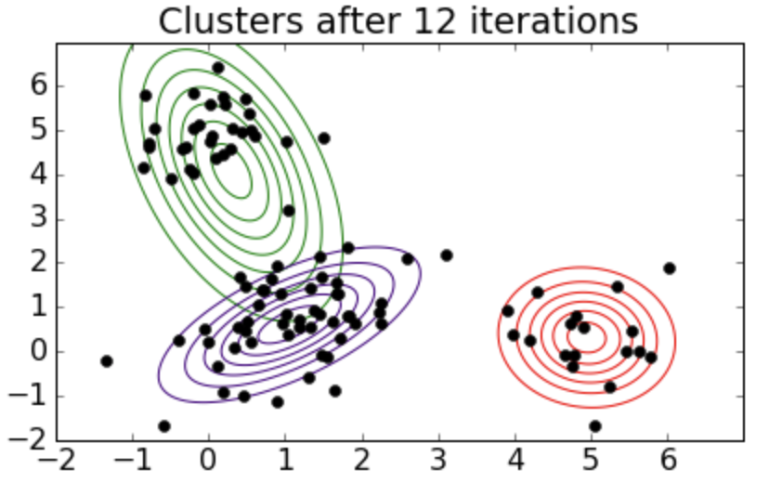
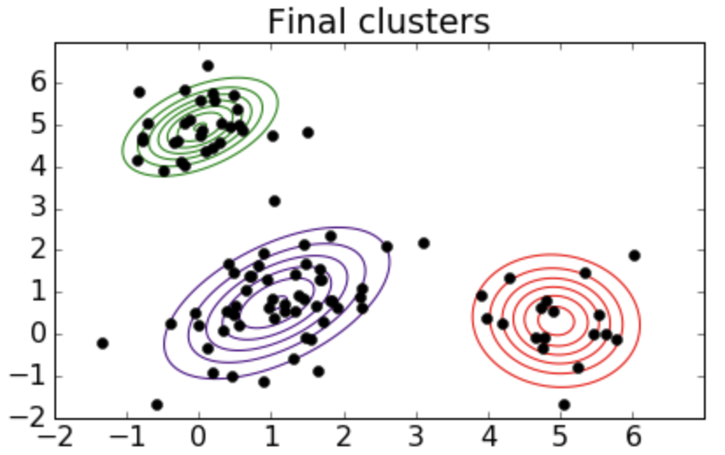
Fitting Gaussian Mixture Model
“Adjust the hats”
E-step: estimate the weight that a picture belongs to each cluster
M-step: maximize likelihood by tuning μ and ∑ of Gaussian normal distributions
from sklearn import mixture
mixture.GMM(n_components=4, covariance_type='full')
multivariate_normal.pdf(data, means, covariances) * weights[k]
Notes:
For example, we initialize three hats trying to cover the potentially three clusters of pictures described by green and blue colors.
Scikit-learn’s GMM model can iterate until the three hats captures data points that are most likely under each of the hats.

Slide 6
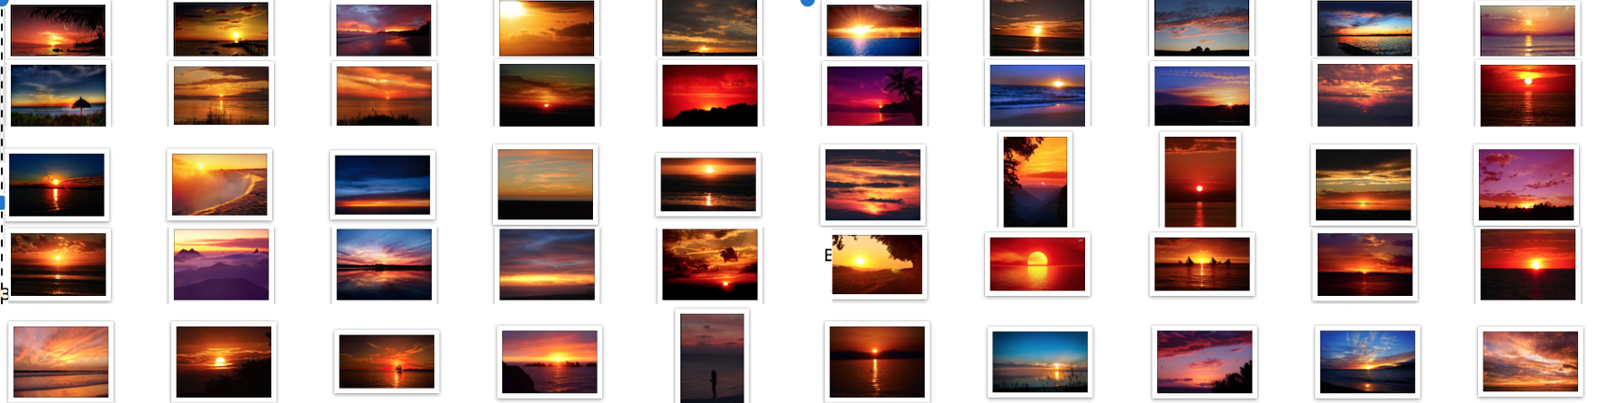
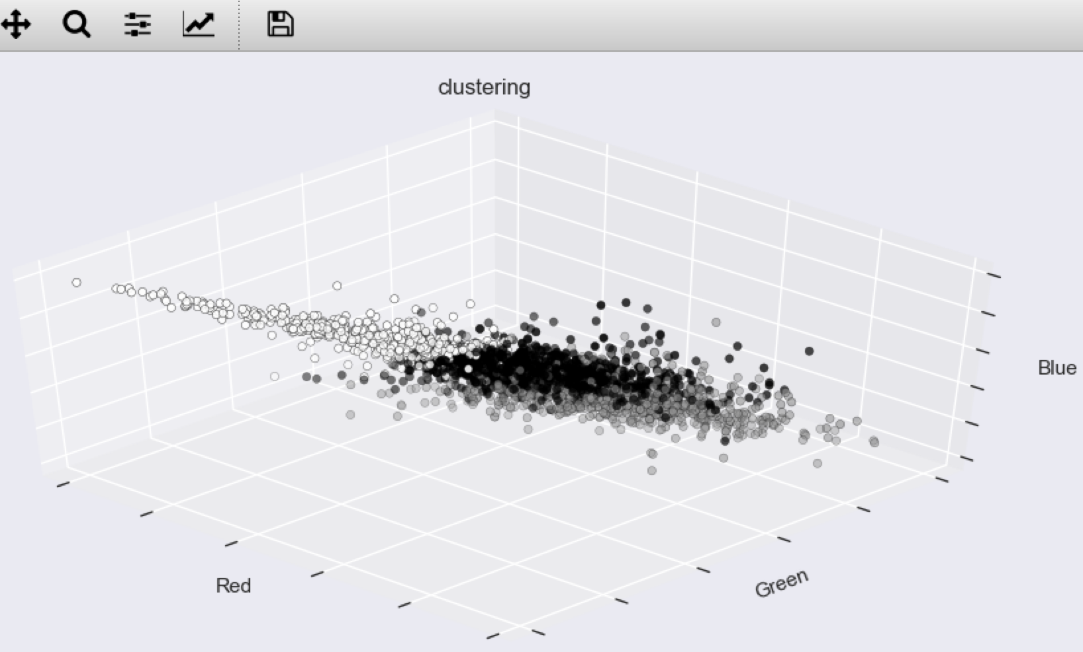

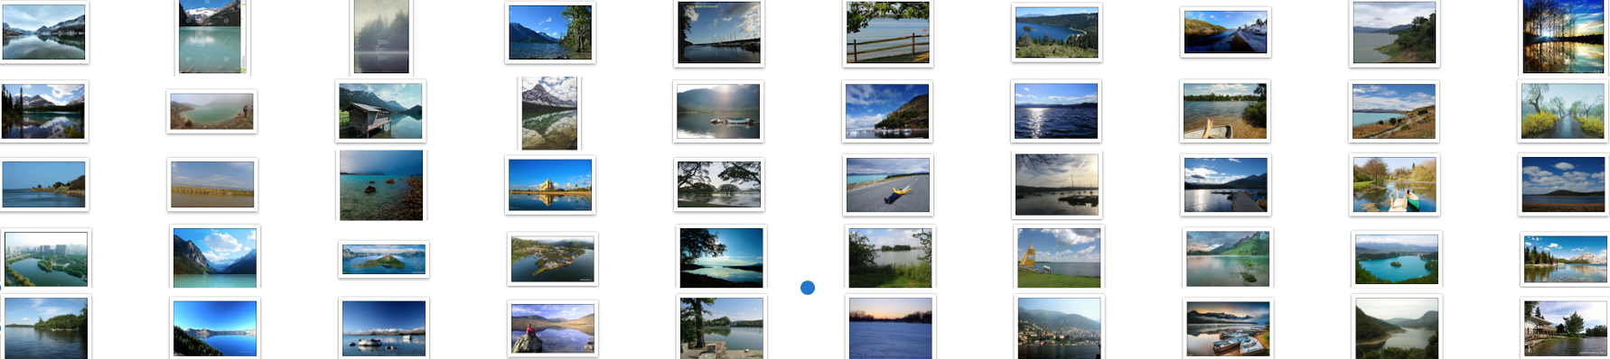
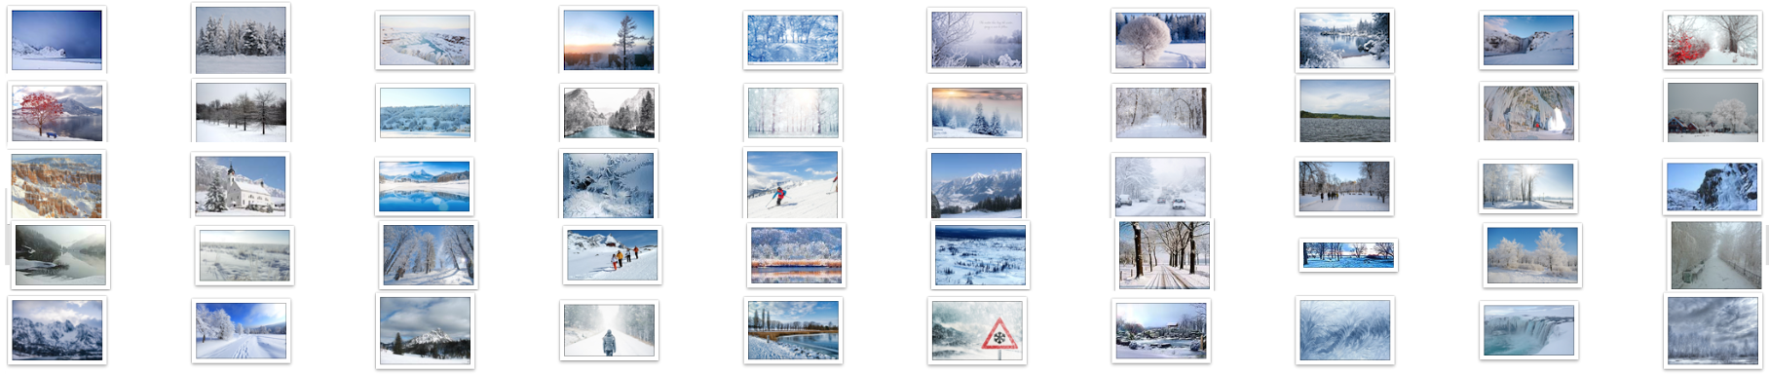
Visualization K-Means
K-Means Models
Clusters
Notes:
Our result from using scikit-learn’s KMeans package to cluster Minnesota natural scenery is pretty straightforward. As you can see, the most pictures of Minnesota scenery appear online are sunset, lakes, and snow. We are quite famous for lakes and snow indeed.

Slide 7
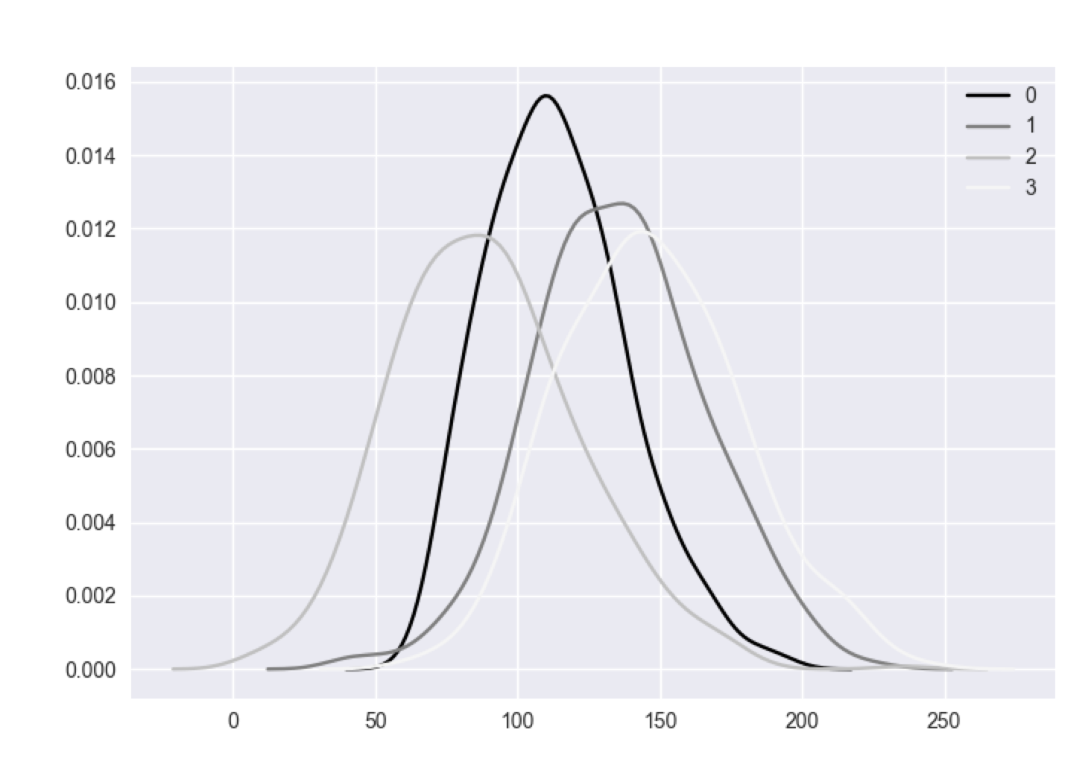
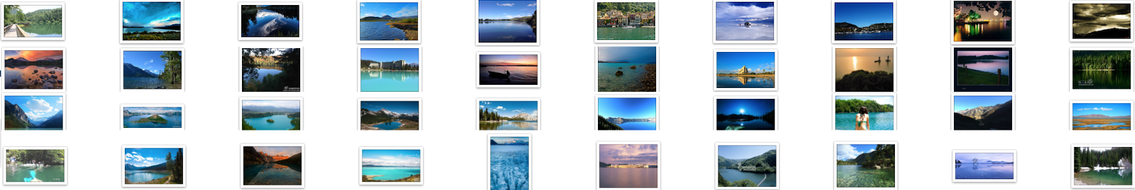
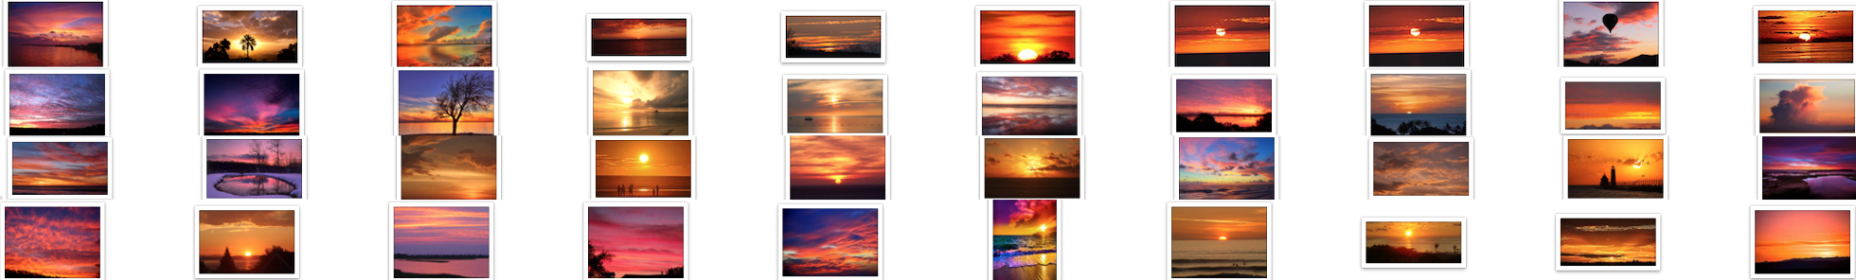
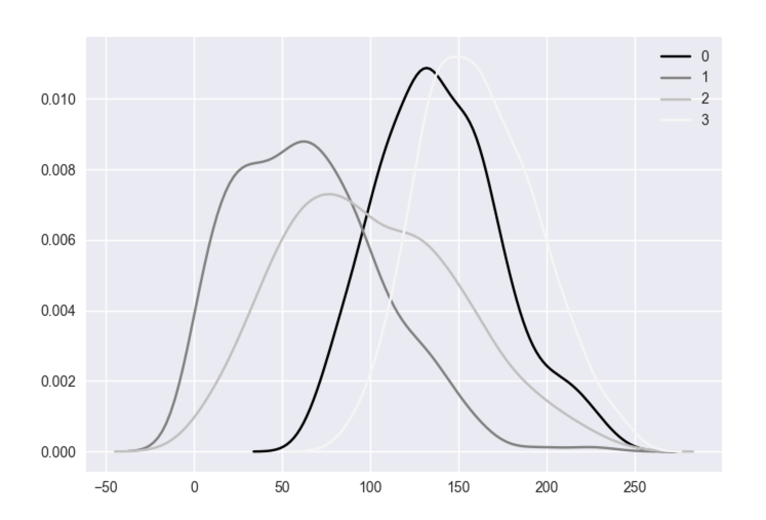
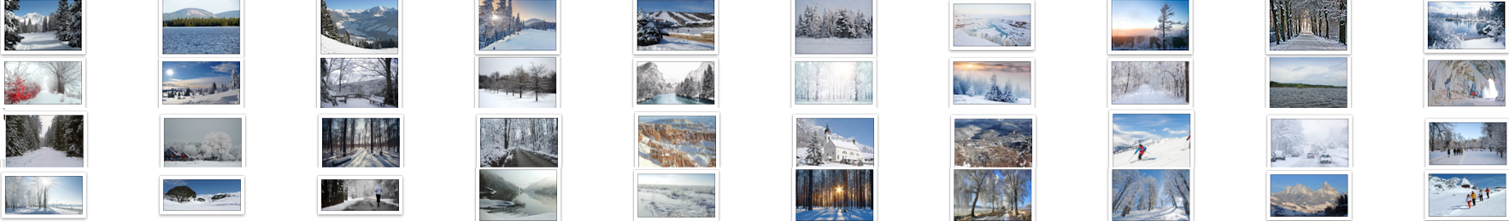
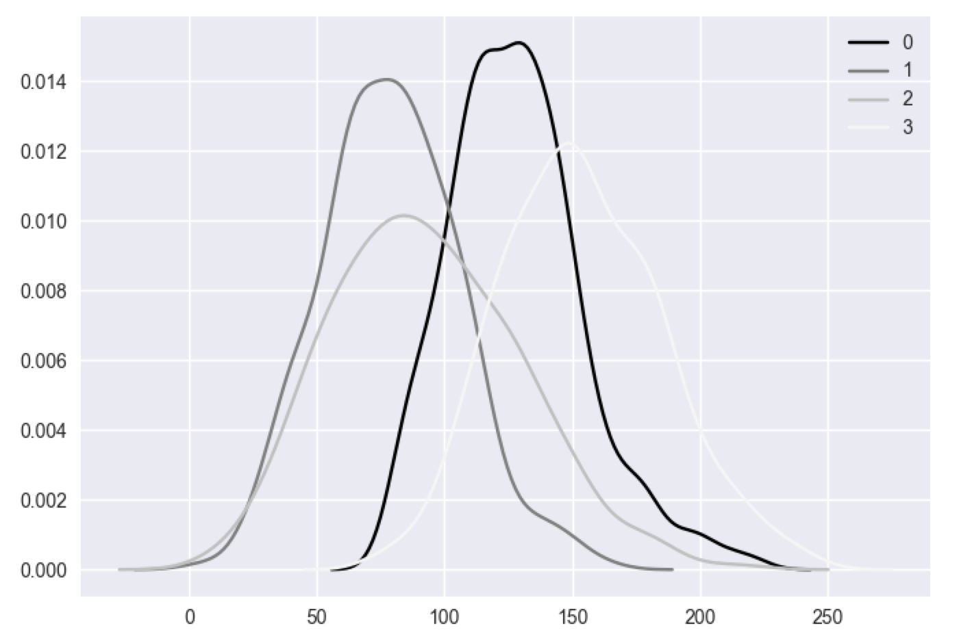
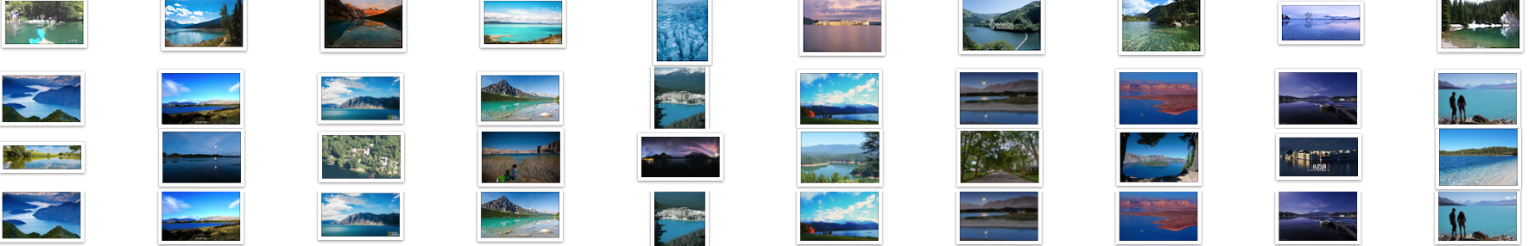
Visualization GMM
GMM Models
Clusters
Notes:
Using Gaussian Mixture Model which we mentioned earlier, we see the patterns we learn just now -- one specific color has a Gaussian distribution of different μ for different clusters of picture.
Here we initialize 4 clusters, and end up seeing maybe 3 clusters is the better way.

Slide 8

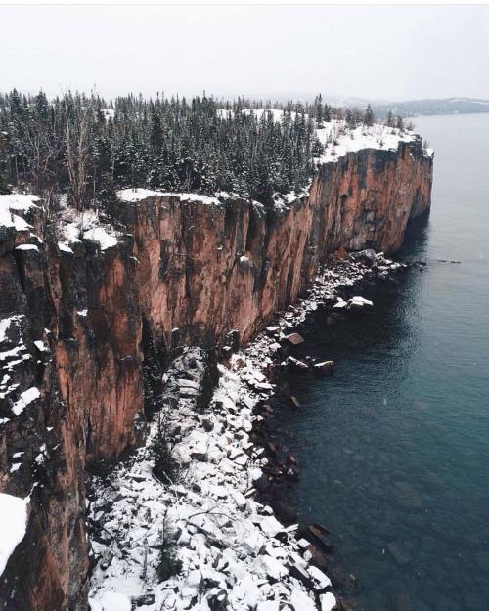
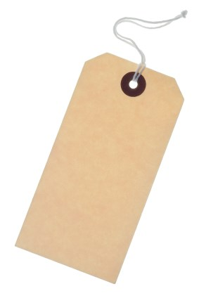
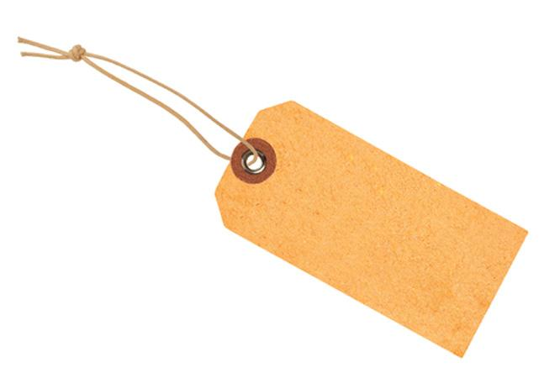
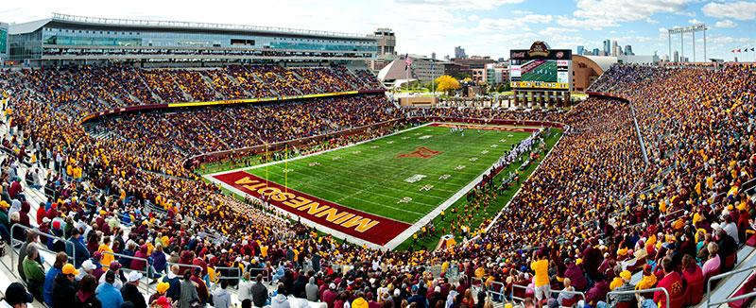
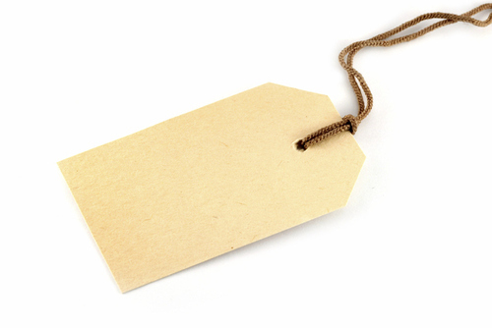
Motivating DL and TensorFlow
Steel arch
bridge 44.06%
Viaduct 9.85%
Pier 26.76%
Cliff 90.28%
Headland 0.90%
Alp 0.50%
Stage 83.00%
Scoreboard 9.04%
Ball player 0.81%
Notes:
But what if the pictures we are dealing with is not as simple as natural scenery, but with more complex elements and complex colors?
RGB features are clearly not enough to tell the whole story. When it comes to large number of features, deep learning kicks in and TensorFlow takes on the more complex computation.

Slide 9
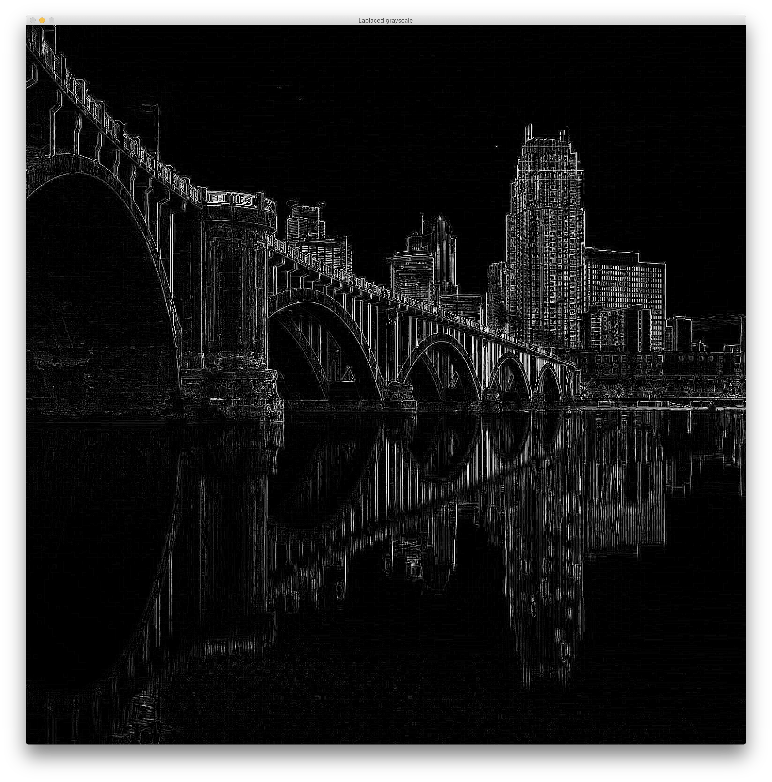
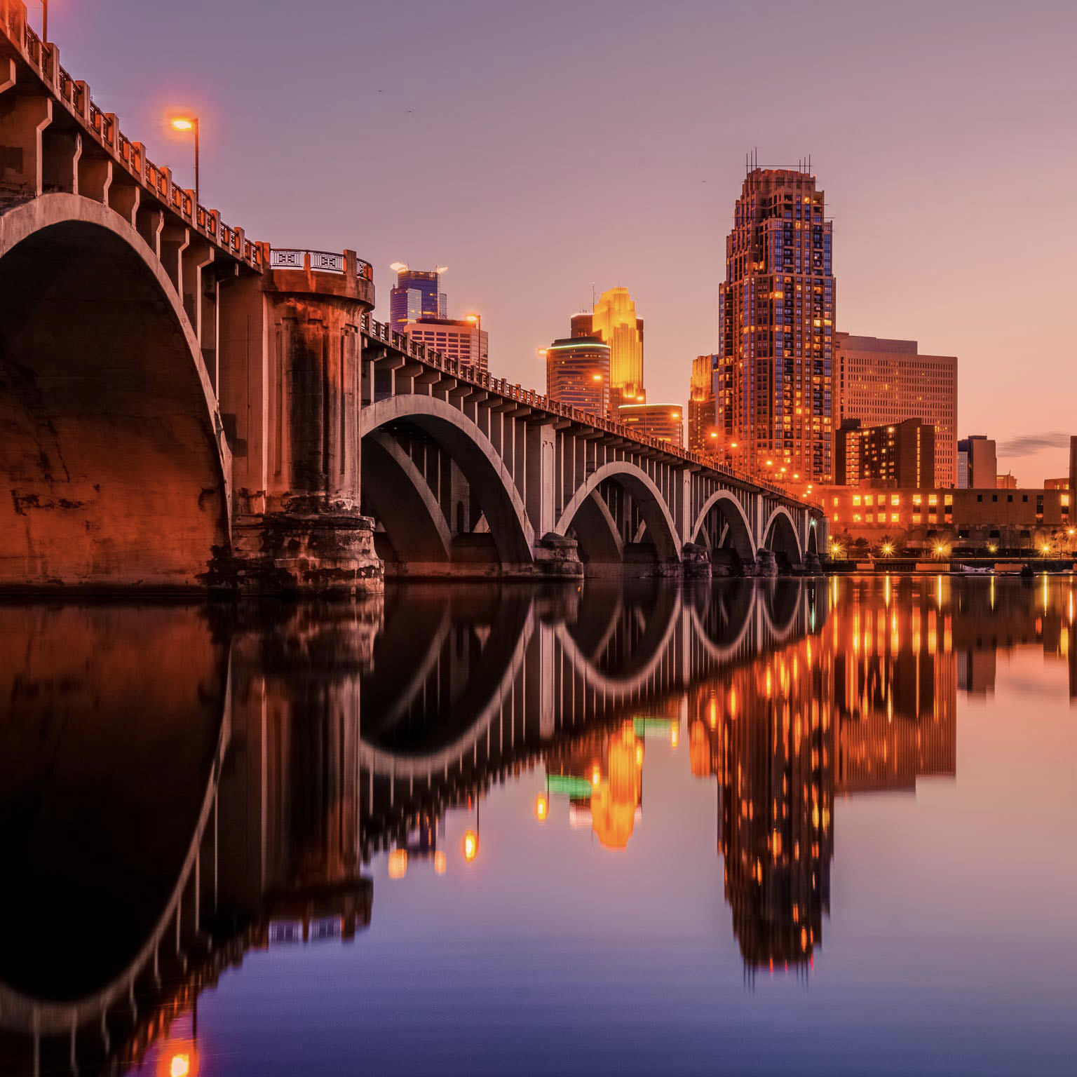
CNN On TensorFlow

Slide 10

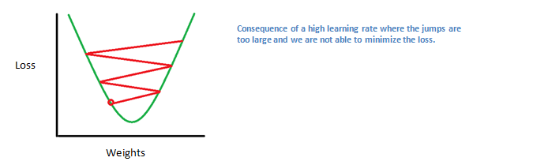
CNN On TensorFlow
Images from: https://adeshpande3.github.io/adeshpande3.github.io/A-Beginner%27s-Guide-To-Understanding-Convolutional-Neural-Networks/

Slide 11
References
[1]. 2.1. Gaussian mixture models. Retrieved August 13, 2017, from
http://scikit-learn.org/stable/modules/generated/sklearn.cluster.k_means.html#sklearn.cluster.k_means
[2]. A Beginner's Guide To Understanding Convolutional Neural Networks.Retrieved August 13, 2017, from
https://adeshpande3.github.io/adeshpande3.github.io/A-Beginner%27s-Guide-To-Understanding-Convolutional-Neural-Networks/
[3]. Ajay, (2017). EMOTION DETECTION USING MACHINE LEARNING. International Journal of recent trends in engineering and research, 2455-2457, 28-32
[4]. Image Recognition. Retrieved August 13, 2017, from
https://www.tensorflow.org/tutorials/image_recognition
[5]. Python-OpenCV 处理图像（五）：图像中边界和轮廓检测. Retrieved August 13, 2017, from
http://blog.csdn.net/qq_26898461/article/details/50454547
[6]. Rectifier (neural networks). Retrieved August 13, 2017, from
https://en.wikipedia.org/wiki/Rectifier_(neural_networks)
[7]. sklearn.cluster.k_means.(). Retrieved August 13, 2017, from
http://scikit-learn.org/stable/modules/generated/sklearn.cluster.k_means.html#sklearn.cluster.k_means
[8]. Softmax function. Retrieved August 13, 2017, from
https://zh.wikipedia.org/wiki/Softmax%E5%87%BD%E6%95%B0
[9]. Understanding Convolutional Neural Networks for NLP. Retrieved August 13, 2017, from
http://www.wildml.com/2015/11/understanding-convolutional-neural-networks-for-nlp/
[10]. Visualizing what ConvNets learn. Retrieved August 13, 2017, from
http://cs231n.github.io/understanding-cnn/
[11]. 卷积网络.Retrieved August 13, 2017, from
https://exacity.github.io/deeplearningbook-chinese/Chapter9_convolutional_networks/
[12]. 浅谈深度学习中的激活函数 - The Activation Function in Deep Learning. Retrieved August 13, 2017, from
http://www.cnblogs.com/rgvb178/p/6055213.html

